Slide 1
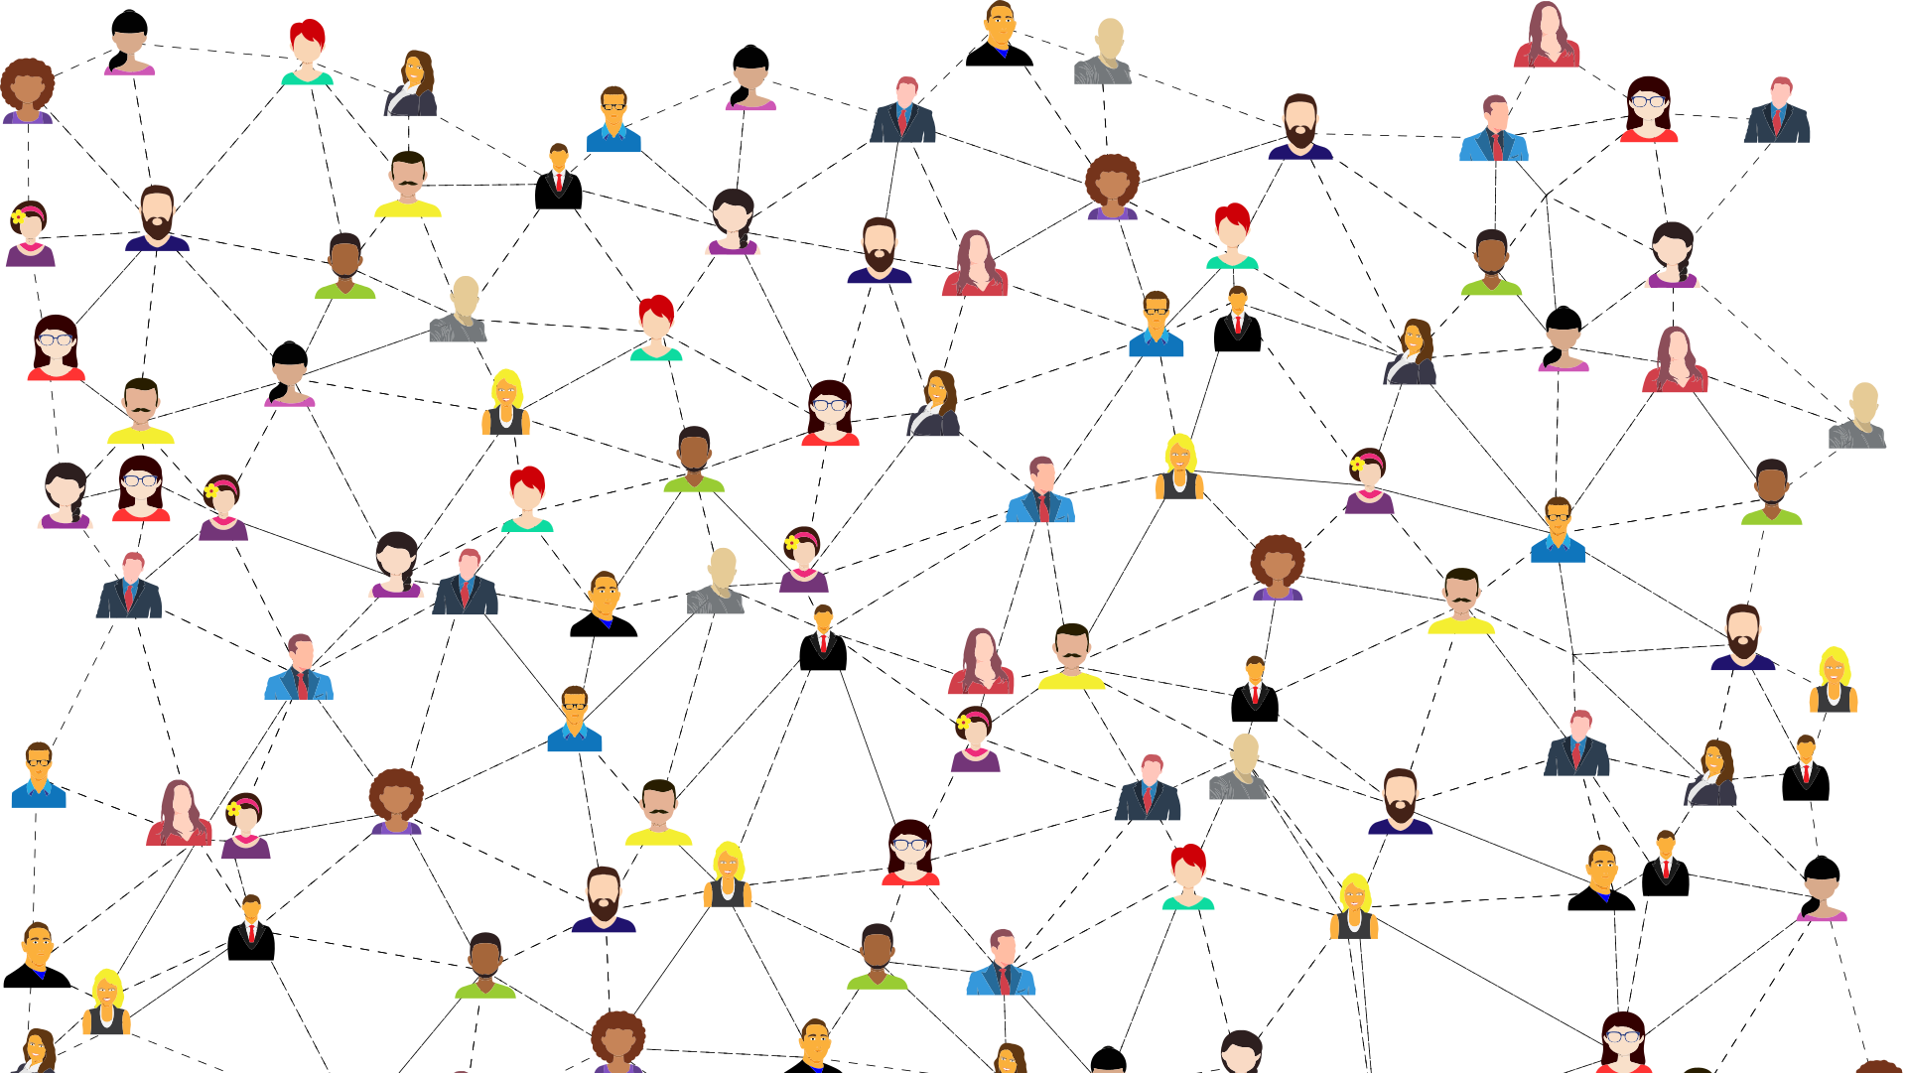
Constructing a digital twin of the social network of Amsterdam
Thesis presentation of Kamiel Gülpen
Dr. Debraj Roy
Dr. Vítor Vasconcelos
Msc Dhruv Mittal

Slide 2

Presentation outline
Data explanation
Data sources main data structure
Layers
Characteristics
Structure
Static network
Basic static network
Extensions
Homophily
SDA Model
Our model
Dynamics
Discussion

Slide 3
Data
Network data of Amsterdam
Source: CBS 2019
4 network layers:
Household
Family
Neighbours
Work / School
Include 240 groups based on person characteristics
age x 8 ethnicity x 5, gender x 2, education x3

Slide 4
Layers
Household
Household relationships
Symmetrical
Include:
Partner,
Housemate,
Housemate institute
Family
Family relationships
Symmetrical
Include:
Aunt/uncle,
co-parent,
sister/brother
Neighbours
10 closes neighbour households within 50 meters
Not Symmetrical
Randomly chosen if multiple neighbours have same distance
Work/School
Work, school and university relationships
Not symmetrical
If more than 100 persons work in the company the 100 persons that live closes by an agent are chosen

Slide 5
Personal characteristics
240 groups based on personal characteristics:
Age group: [0-20), [20-30) … [80-120]
Ethnicity: Native, Moroccan, Turkish, Surinamese, Other
Education: 1 (low), 2 (middle), 3 (high)
Gender: Man, Woman

Slide 6
Data structure
2 different kind of datasets:
Agent dataset
Connection dataset
Age | Ethnicity | Education | Gender | Amount(n)
[0-20) | Native | 1 | Man | 30829
[50-60) | Moroccan | 3 | Woman | 105
… | … | … | … | …
Age Source | Ethnicity Source | Education Source | Gender Source | Age Dest | Ethnicity Dest | Education Dest | Gender Dest | Amount(n) | Proportion(fn) | N
[0-20) | Native | 1 | Man | [20-30) | Moroccan | 1 | Man | 600 | 0.0070038 | 194
[50-60) | Moroccan | 3 | Woman | [0-20) | Moroccan | 1 | Woman | 440 | 0.1617647 | 32
… | … | … | … | … | … | … | … | … | … | …

Slide 7
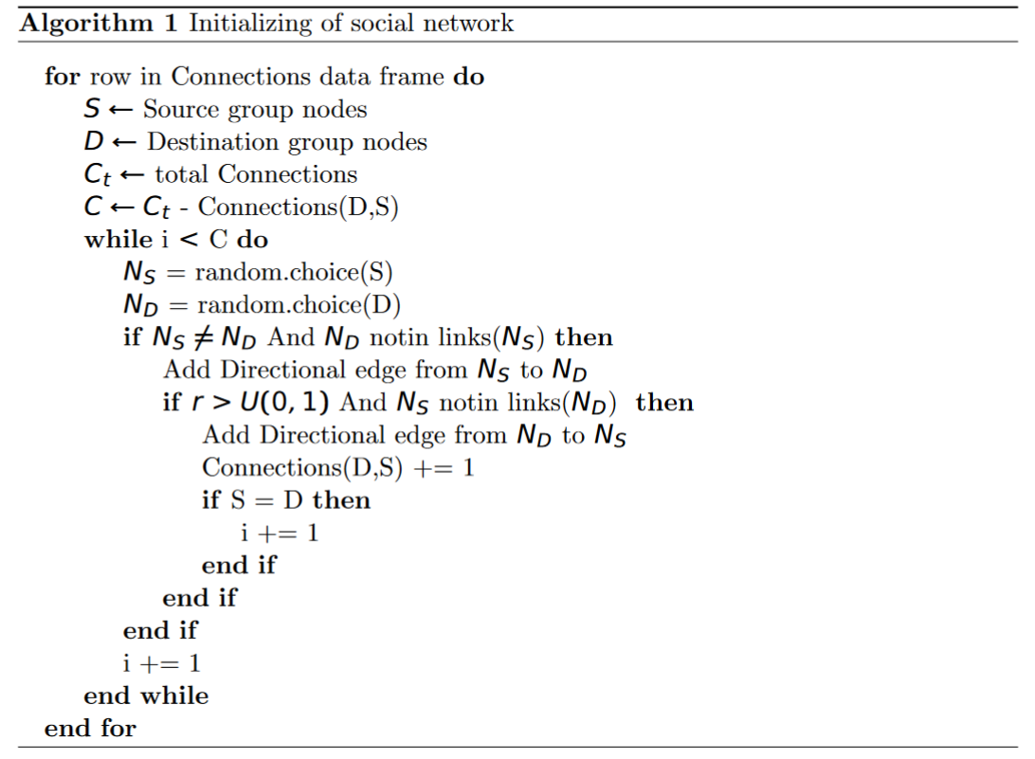
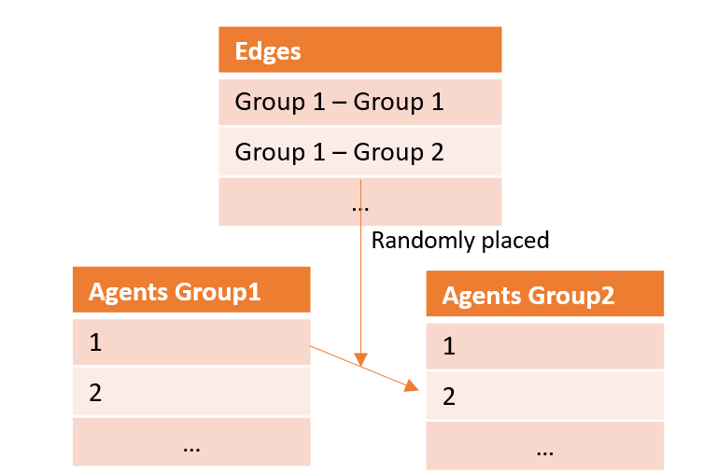
Creation basic static network
Creating a static network based on datasets
Random network
The method looks like the ER algorithm when the groups are the same

Slide 8
Making extensions on the static network
Each layer needs a different approach due to the differences between them.
Work school:
Adding a scale-free parameter that interpolates between ER and BA algorithms when the two groups are the same.
Neighbours:
Adding neighbourhoods, look how persons are distributed in neighboourhoods and make connections within those neighbourhoods based on basis bestand-gebieden-amsterdam-bbga
Households:
Making households based on The DNB Household undertaken by Center data at Tilburg University
Family:
Let a percentage of family connections overlap with connections households

Slide 9

Network Analysis
x

Slide 10
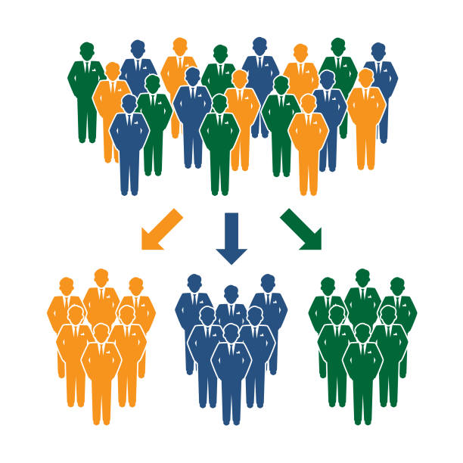
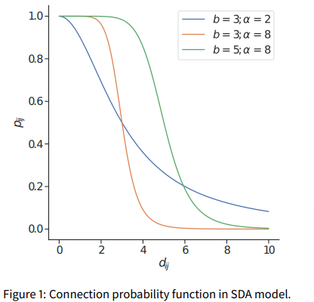
Homophily
Social structure and social networks are related through the fundamental principle of homophily
Agents that are similar with respect to some significant social features are more likely to be somehow connected than dissimilar agents
Is this idea represented in the data?

Slide 11
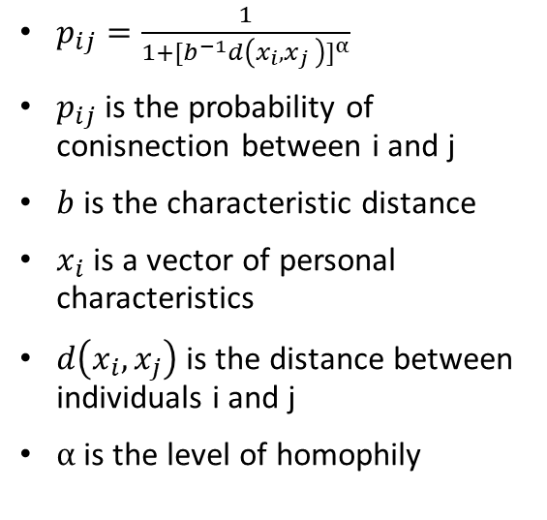
Social Distance Attachment model
$p_{ij}=\frac{1}{{1+[b^{−1}d\left(x_{i},x_{j }\right)]}^{α}}$
$p_{ij}$ is the probability of conisnection between i and j
$b$ is the characteristic distance
$x_{i}$ is a vector of personal characteristics
$d\left(x_{i}, x_{j}\right)$is the distance between individuals i and j
$α$ is the level of homophily

Slide 12
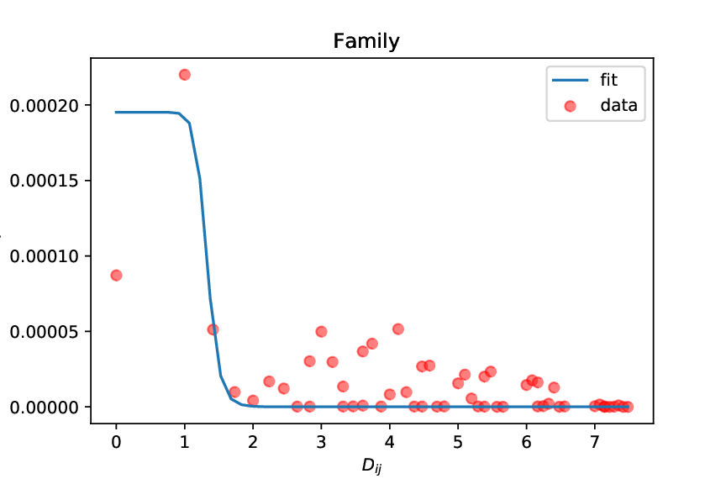
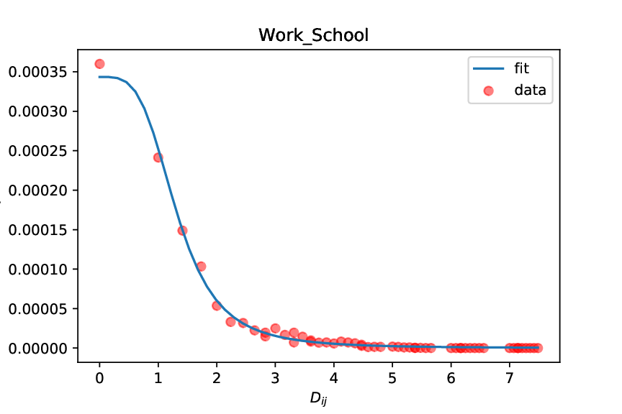
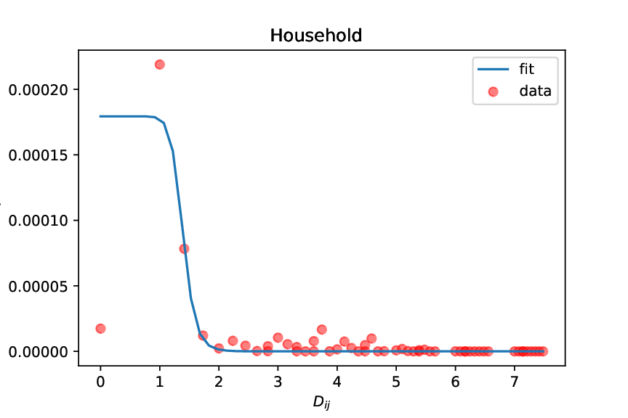
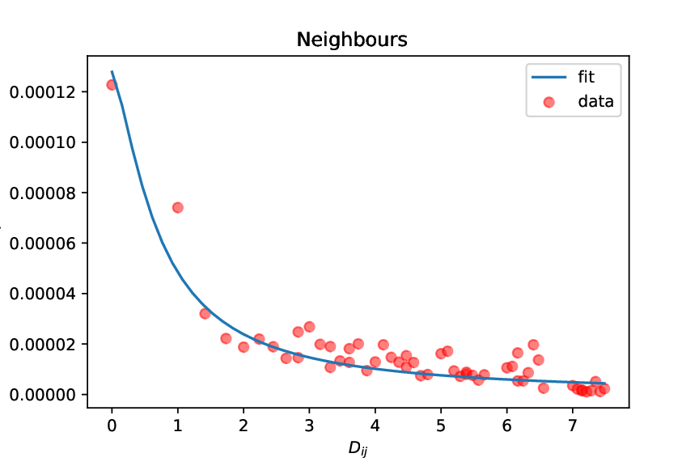

Using this model to fit the data
$p_{ij}=\frac{a}{{1+[b^{−1}d\left(x_{i},x_{j }\right)]}^{α}}$
$a$ is a free variable which is the maximum probability in the original formula.

Slide 13
Validity problem
Formula does not fit all layers
Work/School ✓
Neighbours ✓
Family ✕
Household ✕
Rewrite formula

Slide 14
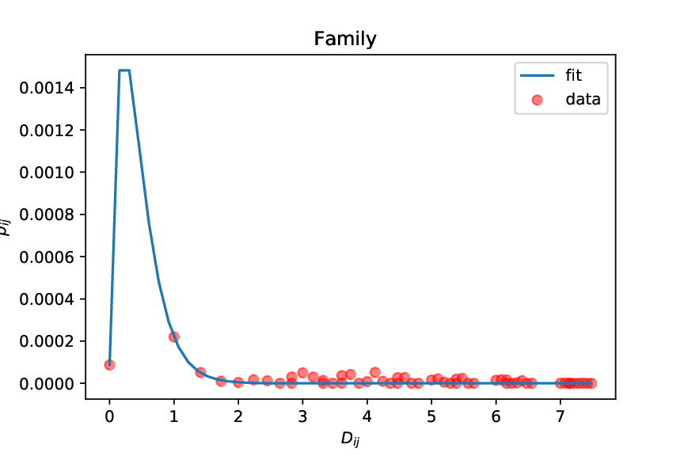
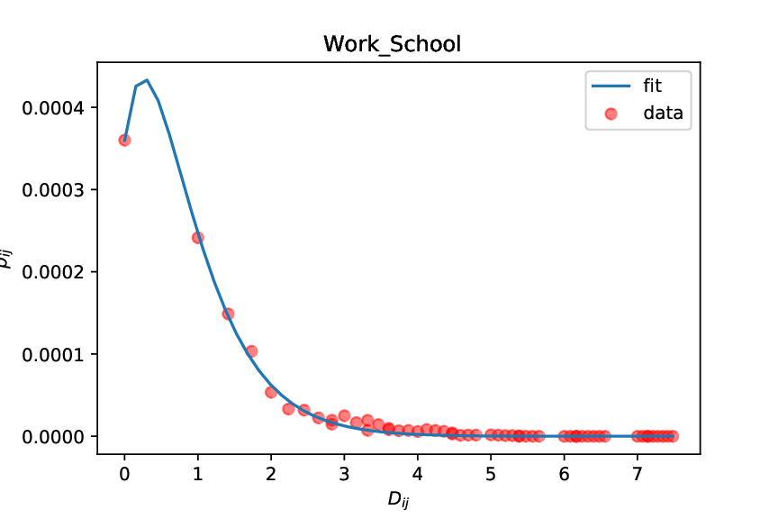
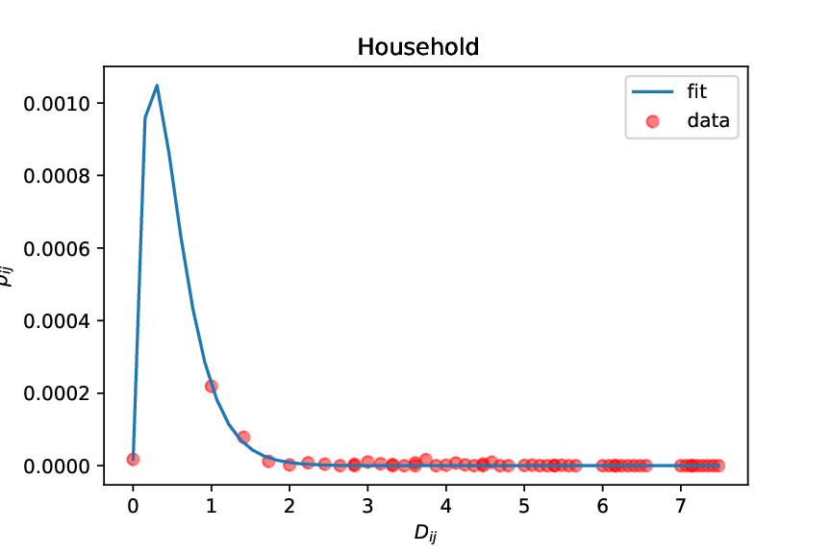
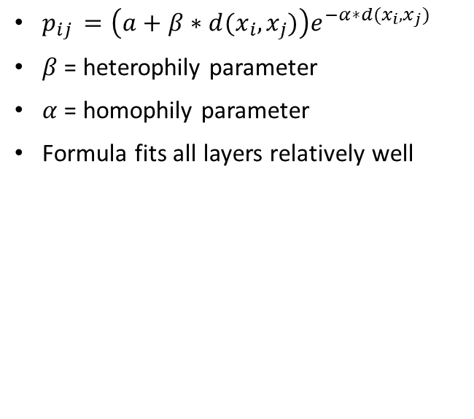
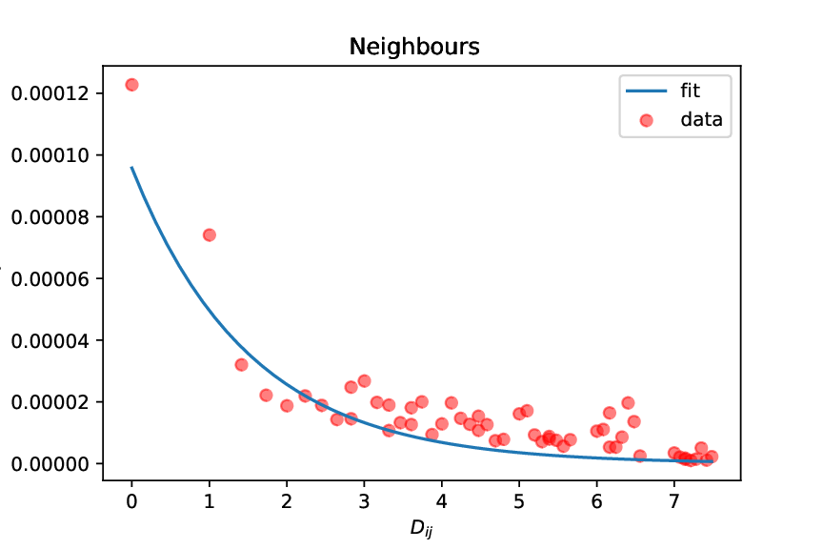
Redefining the formula
$p_{ij }=\left(a+β∗d(x_{i}, x_{j})\right)e^{−α∗d(x_{i}, x_{j})}$
$β$ = heterophily parameter
$α$ = homophily parameter
Formula fits all layers relatively well

Slide 15

Weighted function
Distance of agents are based on different characteristics
Not all characteristics evenly important (McPherson, Smith-Lovin & Cook 2001)
Weighted function is introduced to find the characteristic importance
$p_{ij }=\left(a+β∗{\sum_{c}{W_{c}d_{c}(x_{i}, x_{j})}}_{ }\right)e^{−α∗\sum_{c}{W_{c}d_{c}(x_{i}, x_{j})}}$
$W_{c}$ is the weight for each characteristic $c$
$d_{c}\left(x_{i}, x_{j}\right)$is the characteristic distance $c$ between individual i and j

Slide 16
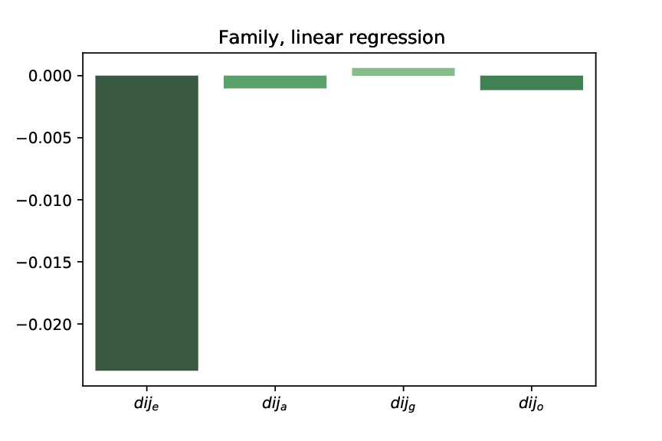
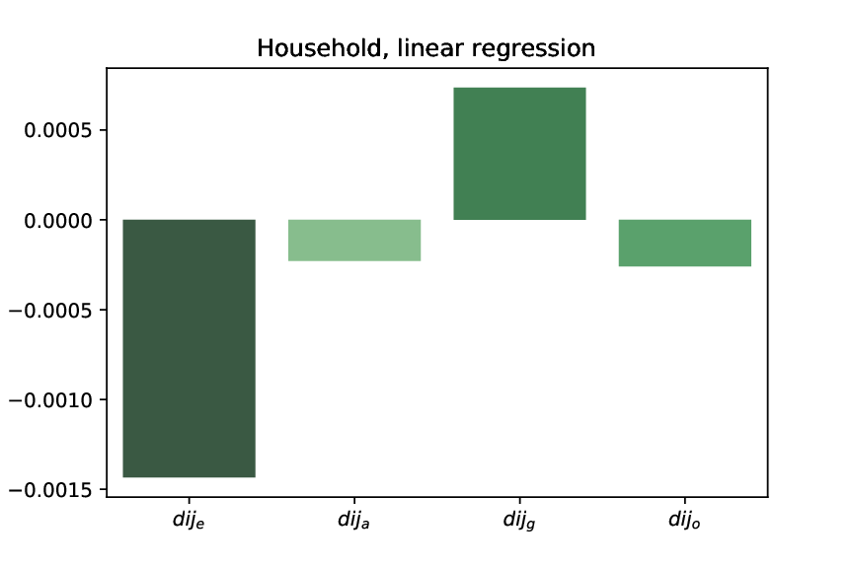
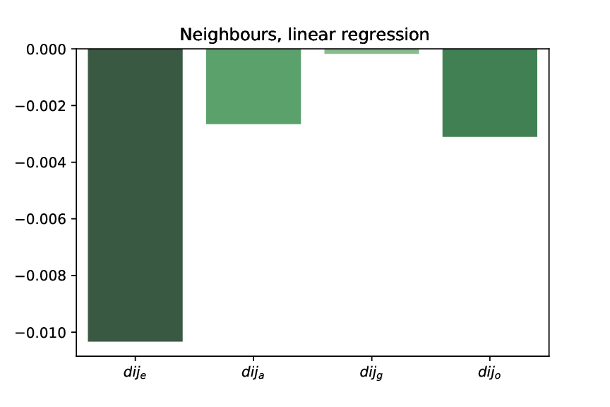
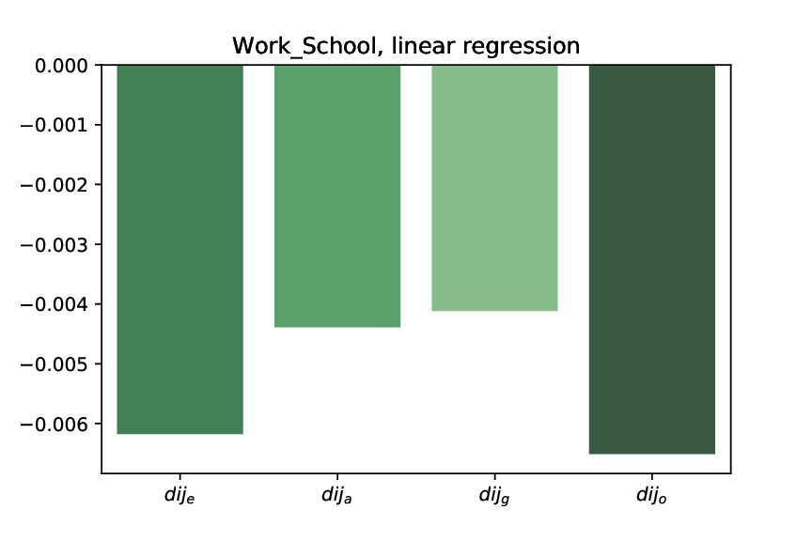
Results weighted function
Ethnicity
Family , household & Neighbours ➔ biggest influence
Work/School ➔ Second highest influence
Age
Family , household & Neighbours ➔ Medium influence
Work/School ➔ High influence
Gender
Family, household ➔ Positive influence
Work/School, Neighbours ➔ Lowest influence
Education
Family, household, neighbours ➔ med high influence
Work/school ➔ Highest influence

Slide 17
Dynamics
An Agent-based approach is used to include the dynamics
Each person is an agent in the Agent-based model
Use Static networks as starting point
Use probability function as for making new connections
Make each time step a new network based on this formula
Introducing other dynamics such as death and birth

Slide 18
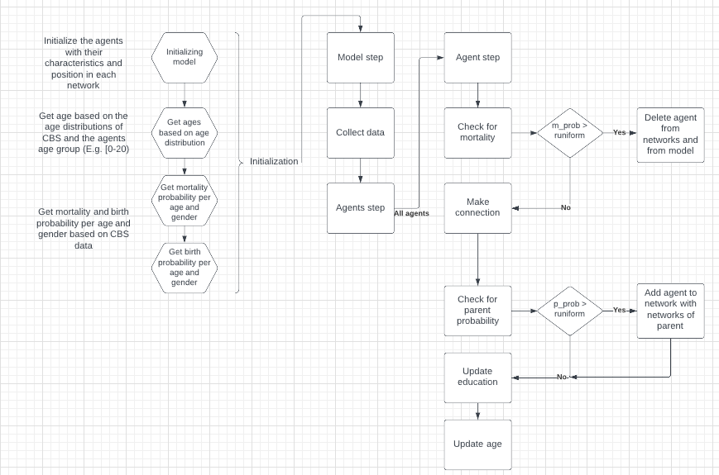
Agent based model flow chart

Slide 19
Discussion
Network analysis and extensions
Model extensions and experiments
Who could be interested in the project
Possible implications

Slide 20
Appendix

Slide 21
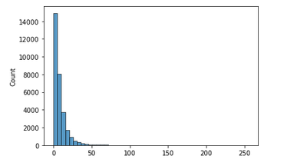
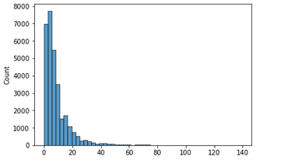
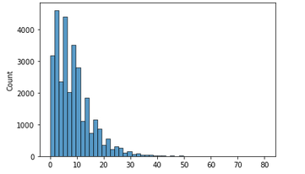
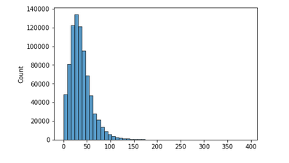
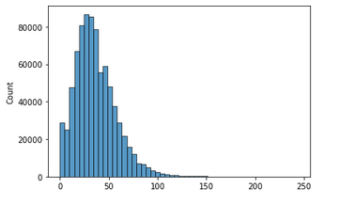
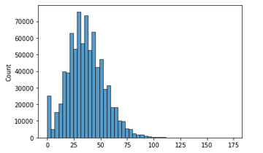
Exponential distribution
When we increase the amount of initial nodes in the destination bin, we see that the distribution between groups start following an exponential distribution and the total network will look more like a normal distribution

Slide 22
Dunbar number in the scale-free network (work/school)
It has been proposed to lie between 100 and 250, with a commonly used value of 150.
With a destination bin of 1% only 66 persons have a higher in degree value than 250, the largest has a in degree of 394 making it more plausible 1% initial nodes more plausible than only 1 node which results in
highest in-degree of 1987 links and 963 nodes above 250 in-degree
Interesting is that with random network the maximum in_degrees lays on 152
2 % has highest value of 312 and only 16 nodes which have a higher value than 250

Slide 23
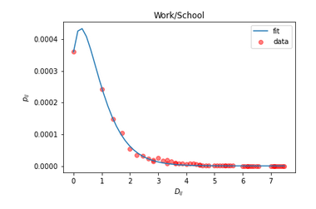
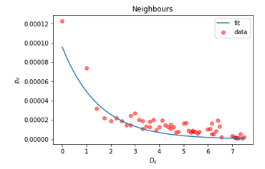
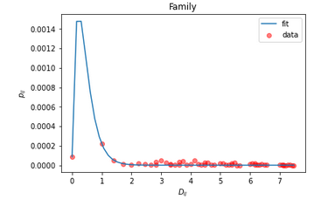
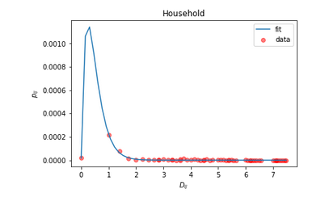
Alpha values
alpha = 1.966
alpha = 0.6588
alpha = 4.435
alpha = 4.046

Slide 24
Alphas for different ethnicity groups
 | Autochtoon | Turks | Marokkaans | Surinaams | Overig
Work/School | 1.96 | 2.2 | 1.69 | 1.58/ | 2.23
Neighbours | 0.26 | 0.43 | 0.307 | 0.47 | 3.57
Family | 2.95 | 6 | 3.07 | 0.99 | 2.59
Household | 2.76 | 6.025 | 2.71 | 3.29 | 2.89

Slide 25
Alphas for different ethnicity groups
 | Autochtoon | Turks | Marokkaans | Surinaams | Overig
Work/School | 1.96 | 2.2 | 1.69 | 1.58/ | 2.23
Neighbours | 0.26 | 0.43 | 0.307 | 0.47 | 3.57
Family | 2.95 | 6 | 3.07 | 0.99 | 2.59
Household | 2.76 | 6.025 | 2.71 | 3.29 | 2.89

Slide 26
Social network results
Looked at the 4 measures that are properties of real world social networks ^{1,2}:
Clustering (transitivity)
Positive degree assortativity
Small-world property ⇒ shortest path, L ∝ log(N) (or smaller)
Community structure (modularity)
Network/ Measurement | Family | Neighbours | Work/School | Household | Combined | Random
Transitivity | 0.00173 | 0.35000 | 0.00025 | 1 | 0.09609 | 5.223744E-6
Modularity | 0.67116 | 0.88477 | 0.38314 | 1 | 0.34357 | -1.74223
SW-property | - | 5.1827 | 4.116 | - | 3.7 | -
Degree assortativity | 0.41728 | 0.09320 | 0.18906 | 1 | 0.12087 | 0.00208

